Slide 1
Automobile customers’ segmentation & Marketing Strategies
Hemant Patidar
19-06-2022

Slide 2
Analysis Steps
Agenda & Executive Summary
Data detailing with shape, state etc.
Exploratory Analysis and Inferences
Univariate & Bivariate analysis.
Customer Segmentation using RFM analysis
Recency, Frequency and Monetary analysis.
Inferences from RFM Analysis and identified segments
Segmented customers analysis and marketing strategies.

Slide 3
Agenda & Executive Summary
The project aims to find the underlying buying patterns of the customers of an automobile part manufacturer based on the past 3 years of the Company's transaction data and hence recommend customized marketing strategies for different segments of customers.

Slide 4
Data Stats
Agenda & Executive Summary
Shape
Data Information
Numbers of Rows: 2747
Number of Fields/Columns: 20
Date time: 1
Numeric: 7 (2 float and 5 integer)
Categorical/Object: 12
NULL or Duplicates
Non-informative fields
Data has NO null values
Data has NO duplicate values
OrderNumber

Slide 5
Summary Stats
Agenda & Executive Summary
Field | count | unique | top | freq | mean | min | 25% | 50% | 75% | max | std
ORDERNUMBER | 2747 | NaN | NaN | NaN | 10259.76156 | 10100 | 10181 | 10264 | 10334.5 | 10425 | 91.877521
QUANTITYORDERED | 2747 | NaN | NaN | NaN | 35.103021 | 6 | 27 | 35 | 43 | 97 | 9.762135
PRICEEACH | 2747 | NaN | NaN | NaN | 101.098951 | 26.88 | 68.745 | 95.55 | 127.1 | 252.87 | 42.042548
ORDERLINENUMBER | 2747 | NaN | NaN | NaN | 6.491081 | 1 | 3 | 6 | 9 | 18 | 4.230544
SALES | 2747 | NaN | NaN | NaN | 3553.047583 | 482.13 | 2204.35 | 3184.8 | 4503.095 | 14082.8 | 1838.953901
ORDERDATE | 2747 | NaN | NaN | NaN | 13/05/2019 | 06/01/2018 | 08/11/2018 | 24/06/2019 | 17/11/2019 | 31/05/2020 | NaN
DAYS_SINCE_LASTORDER | 2747 | NaN | NaN | NaN | 1757.085912 | 42 | 1077 | 1761 | 2436.5 | 3562 | 819.280576
STATUS | 2747 | 6 | Shipped | 2541 | NaN | NaN | NaN | NaN | NaN | NaN | NaN
PRODUCTLINE | 2747 | 7 | Classic Cars | 949 | NaN | NaN | NaN | NaN | NaN | NaN | NaN
MSRP | 2747 | NaN | NaN | NaN | 100.691664 | 33 | 68 | 99 | 124 | 214 | 40.114802
PRODUCTCODE | 2747 | 109 | S18_3232 | 51 | NaN | NaN | NaN | NaN | NaN | NaN | NaN
CUSTOMERNAME | 2747 | 89 | Euro Shopping Channel | 259 | NaN | NaN | NaN | NaN | NaN | NaN | NaN
PHONE | 2747 | 88 | (91) 555 94 44 | 259 | NaN | NaN | NaN | NaN | NaN | NaN | NaN
ADDRESSLINE1 | 2747 | 89 | C/ Moralzarzal, 86 | 259 | NaN | NaN | NaN | NaN | NaN | NaN | NaN
CITY | 2747 | 71 | Madrid | 304 | NaN | NaN | NaN | NaN | NaN | NaN | NaN
POSTALCODE | 2747 | 73 | 28034 | 259 | NaN | NaN | NaN | NaN | NaN | NaN | NaN
COUNTRY | 2747 | 19 | USA | 928 | NaN | NaN | NaN | NaN | NaN | NaN | NaN
CONTACTLASTNAME | 2747 | 76 | Freyre | 259 | NaN | NaN | NaN | NaN | NaN | NaN | NaN
CONTACTFIRSTNAME | 2747 | 72 | Diego | 259 | NaN | NaN | NaN | NaN | NaN | NaN | NaN
DEALSIZE | 2747 | 3 | Medium | 1349 | NaN | NaN | NaN | NaN | NaN | NaN | NaN

Slide 6
Summary Stats (Assumption)
Agenda & Executive Summary
Lower 25 percentile customers’ average order of 27 quantities whereas upper 25 percentile orders 43 quantities.
There are high value customers their average item price is high and they purchase in more quantities.
Most of the purchases are happening from USA country.
City-wise Madrid generates more purchases compared to others.
The oldest order was of June’18 and most recent order was of May 31, 2020

Slide 7
Exploratory Analysis and Inferences
EDA helps identify errors in data sets. Gives a better understanding of the data set. Helps detect outliers or anomalous events. Helps understand data set variables and the relationship among them.

Slide 8
Visualization Types
Exploratory Analysis and Inferences
Univariate Analysis
Analysis of single variable either categorical or numeric one
Bi-Variate Analysis
Analysis between 2 variables to identify relationship between them
Multi-Variate Analysis
Bi-Variate Analysis with a hue, where presence of 3rd variable can be analysed against those two.
Trend
Date trend against sales help us identify seasoning and pattern

Slide 9
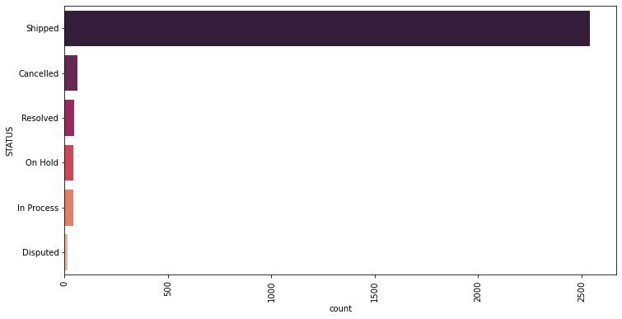
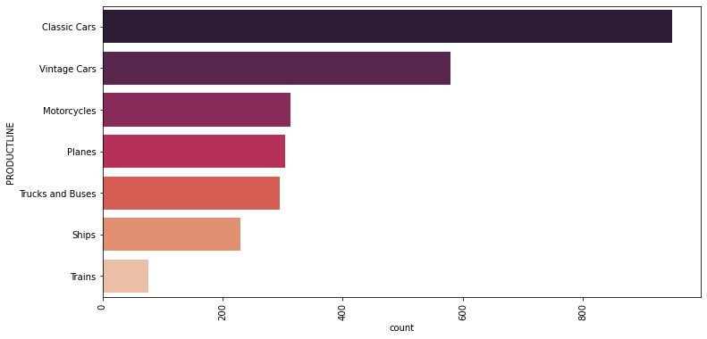
Exploratory Analysis and Inferences
Univariate Analysis
Order Status
Most orders are already shipped
Very less numbers of orders are disputed
Order Product Line
Classic cars are mostly ordered followed by vintage cars
Less number of orders for trains

Slide 10
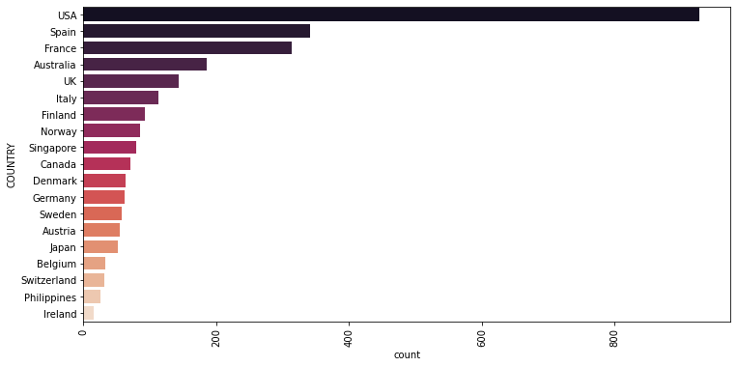
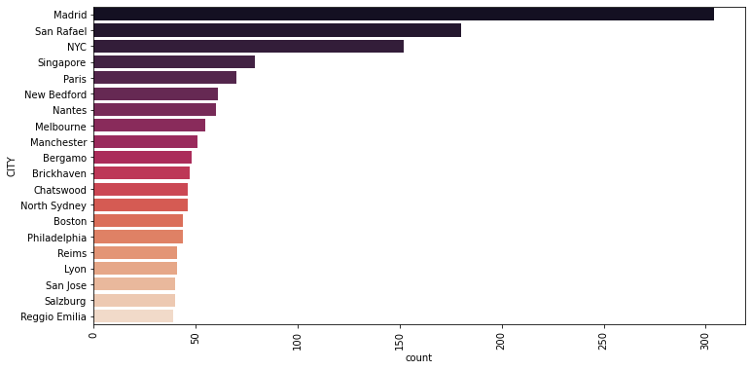
Exploratory Analysis and Inferences
Univariate Analysis
Country-wise Orders
Most orders were purchased from USA
Ireland has least number of orders placed
City-wise Orders
Madrid has most numbers of orders purchased
Plot displays top 20 city by number of orders

Slide 11
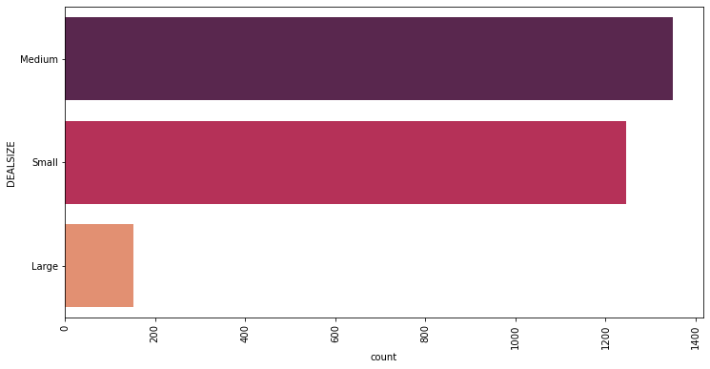
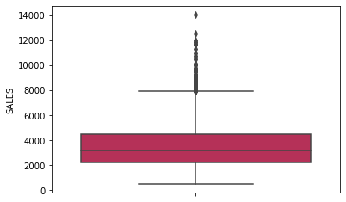
Exploratory Analysis and Inferences
Univariate Analysis
Orders’ Deal Size
Mostly medium size orders were purchased
Large size orders are comparatively very less.
Sales
The median value for sales lies between 2000 to 4000
Outliers can be seen in data due to high valued ordered with lesser frequency.

Slide 12
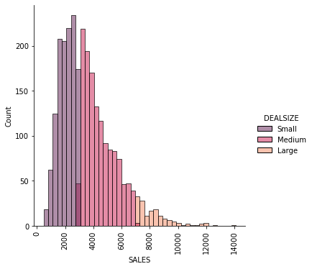
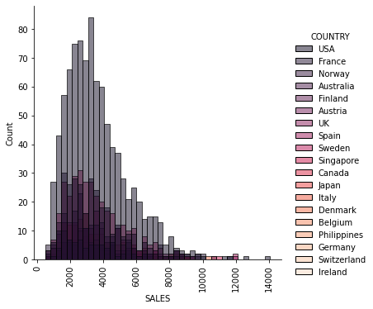
Exploratory Analysis and Inferences
Bi-variate Analysis
Deal Size vs. Sales
Number of high value deals are lesser compared to others
Medium size deal are happening often than small or high
County vs. Sales
USA has most numbers of orders and many of them are medium valued sales

Slide 13
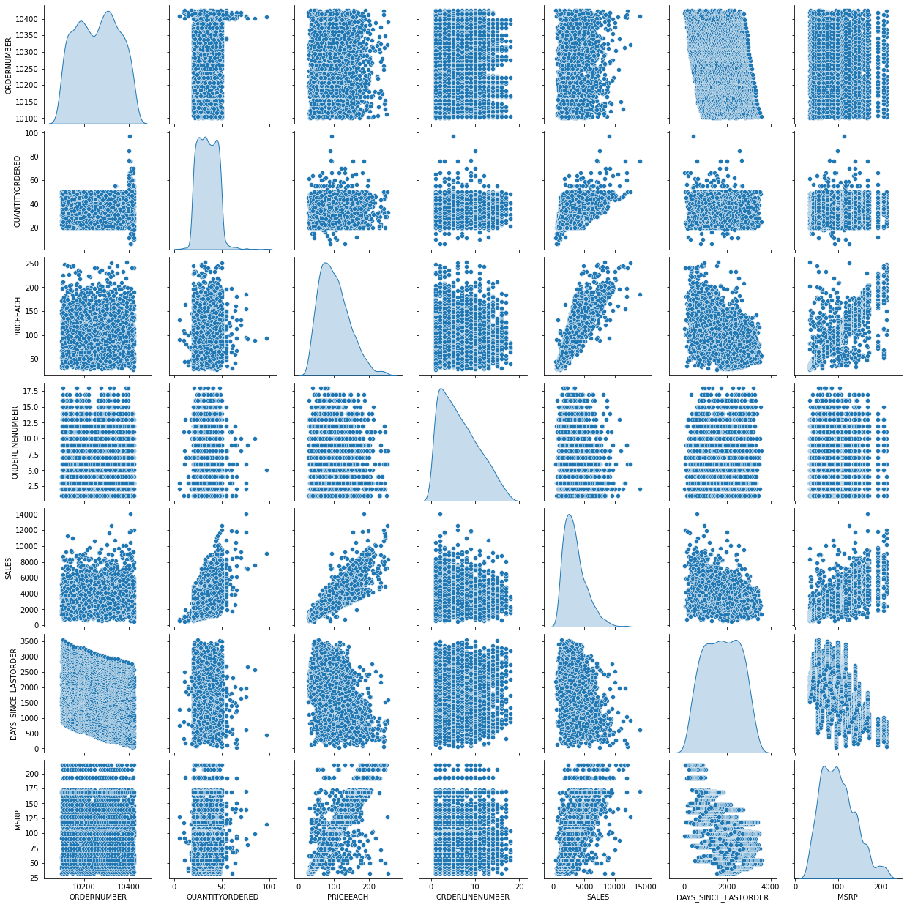
Exploratory Analysis and Inferences
Multi-variate Analysis
INTERFERENCE
Sales and each product’s price having kind of linear relationship
With increasing MSRP, sales seem increasing
Sales data distribution is following normal distribution

Slide 14
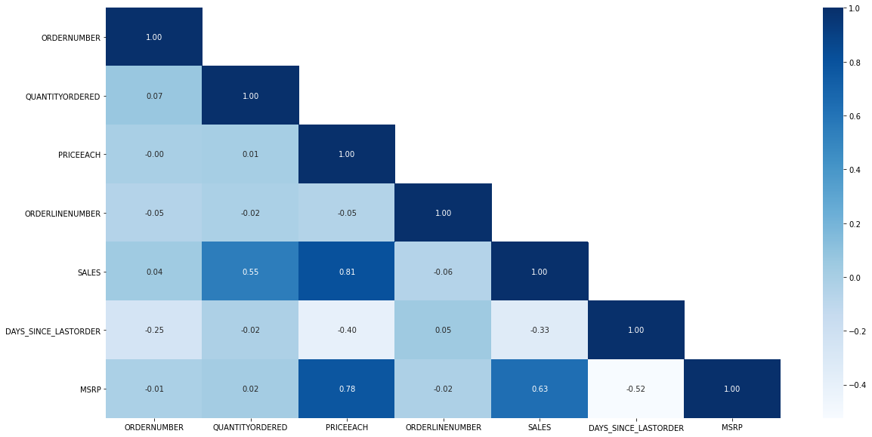
Exploratory Analysis and Inferences
Multi-variate Analysis
INTERFERENCE
Sales vs. Each product price are highly correlated
Sales vs. MSRP are highly correlated
Quantity ordered is correlated with sales
MSRP seems negatively correlated with number of days, means MSRP for product was less in the past.

Slide 15
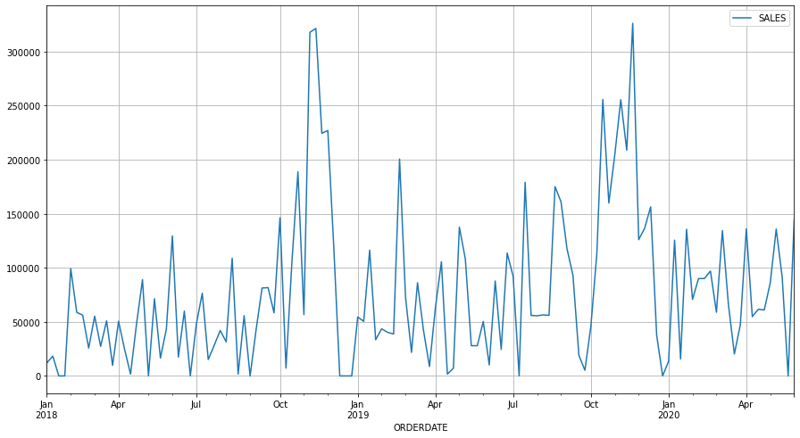
Exploratory Analysis and Inferences
Trend Analysis (Weekly)
INTERFERENCE
Sales are never in always increasing mode for consecutive weeks
Period Oct – Jan seems to have high sales, but it is not consistently increasing every week

Slide 16
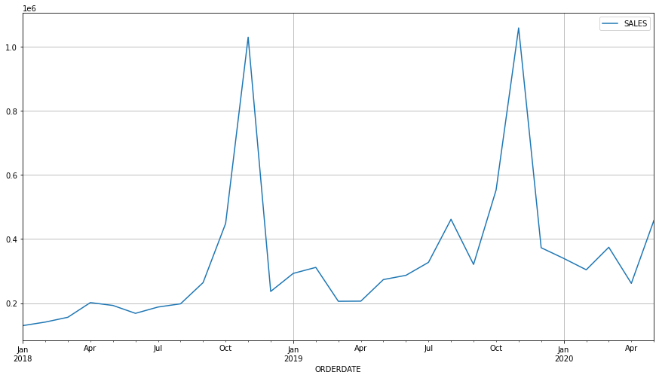
Exploratory Analysis and Inferences
Trend Analysis (Monthly)
INTERFERENCE
Sales seems seasoning high between Oct and Jan
There was a drop in sales after February 2019 in March and April.
April 2020 has lower sales against compared to last 10-11 months.

Slide 17
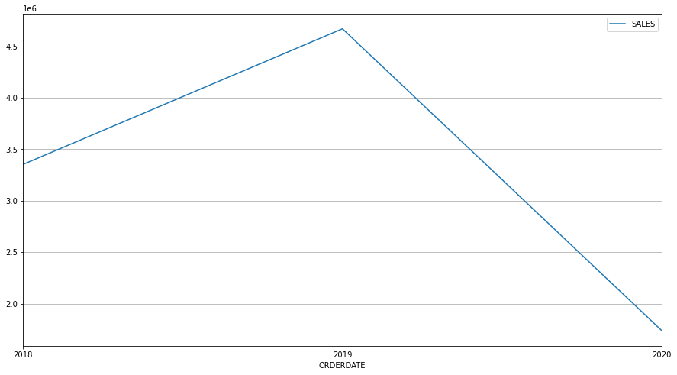
Exploratory Analysis and Inferences
Trend Analysis (Yearly)
INTERFERENCE
Sales were highest in 2019
In year 2020 we have lowest sale compared to other 2 years

Slide 18
Customer Segmentation using RFM analysis
Customer segmentation is the process by which you divide your customers up based on common characteristics.
RFM analysis is a marketing technique used to quantitatively rank and group customers based on the recency, frequency and monetary total of their recent transactions to identify the best customers and perform targeted marketing campaigns.

Slide 19
What Is RFM?
Customer Segmentation using RFM analysis
RFM stands for Recency, Frequency, and Monetary value, each corresponding to some key customer trait. These RFM metrics are important indicators of a customer’s behavior because frequency and monetary value affects a customer’s lifetime value, and recency affects retention, a measure of engagement.

Slide 20
RFM Metrics
Customer Segmentation using RFM analysis
RECEncy
Frequency
monetary
The freshness of the customer’s activity, be it purchases or visits
The frequency of the customer transactions or visits
The intension of customer of spend or purchasing power of customer

Slide 21
Parameters Used
Customer Segmentation using RFM analysis
Assumption made
Days_SINCE_lastorder
Segmentation type
The field already captures RECENCY of R-F-M metrics, it shows the number of days since the last order purchased
We will analyse CUSTOMER segmentation not order segmentation
Frequency (COUNT OF ORDERS)
Scoring method
We have grouped data against CUSTOMERNAME to get number of orders made by single customer
With quantile scoring method, we will identify R-F-M in 5 different buckets.
SALES
BinS classification
Sales total would be our MONETARY value in RFM metrics. We have calculated this against customer name
Recency → 0 (high number of days) – 5 (low number of days)
Frequency → 0 (Rare purchase) – 5 (high purchase count)
Monetary → 0 (Lower sales) – 5 (Higher sales)

Slide 22
Output table (RFM BINS & Clusters)
Customer Segmentation using RFM analysis
Customer Segmentation (Example)
CUSTOMERNAME | recency | frequency | monetary | cluster | recency_scores | frequency_scores | monetary_scores
AV Stores, Co. | 421 | 51 | 157807.81 | 1 | 3 | 5 | 5
Alpha Cognac | 675 | 20 | 70488.44 | 0 | 1 | 2 | 2
Amica Models & Co. | 328 | 26 | 94117.26 | 3 | 4 | 3 | 3
Anna's Decorations, Ltd | 131 | 46 | 153996.13 | 1 | 5 | 5 | 5
Atelier graphique | 312 | 7 | 24179.96 | 3 | 4 | 1 | 1
Australian Collectables, Ltd | 1018 | 23 | 64591.46 | 0 | 1 | 2 | 1
Output Summary
cluster | recency | frequency | monetary | recency_scores | frequency_scores | monetary_scores
0 | 798.68 | 20.41 | 67,481.99 | 1.14 | 2.05 | 1.91
1 | 215.93 | 33.30 | 119,050.88 | 4.50 | 3.77 | 3.87
2 | 130.50 | 219.50 | 783,576.09 | 5.00 | 5.00 | 5.00
3 | 451.37 | 24.57 | 89,626.84 | 2.74 | 2.71 | 2.83

Slide 23
Cluster analysis
Customer Segmentation using RFM analysis
Cluster 1
Cluster 3
Cluster 0
Cluster 2
Best customers
Loyal customers
AvG Customers
LOST customers
Cluster 2 has customers with high monetary values, and they are frequent visitors. They have also visited recently.
Cluster 1 has customers those were visited more recently, and their monetary values and frequency are on higher side.
Cluster 3 has customers with average monetary values, and they are average visitors.
Cluster 0 customers are rare visitors, and they don’t spend much. We don’t see them visiting in recent times.

Slide 24
Inferences from RFM Analysis and identified segments
RFM Analysis divided all customers in 5 bins (1-5) for each recency, frequency and monetary metrics. Best customers can be identified with highest bin categorization in all 3 metrics.
K-Means segmentation helps us in creating specific numbers of segments against all permutations can be created by RFM analysis.

Slide 25
Best customers
Inferences from RFM Analysis and identified segments
Selection Criteria
R – 5
F – 5
M – 5
Customers who are classified in top R-F-M bins (5-5-5) would be our best customers.
Customer | Recency | Frequency | Monetary
Euro Shopping Channel | 42 | 259 | 912,294.11
Mini Gifts Distributors Ltd. | 219 | 180 | 654,858.06
La Rochelle Gifts | 139 | 53 | 180,124.90
Land of Toys Inc. | 216 | 49 | 164,069.44
The Sharp Gifts Warehouse | 182 | 40 | 160,010.27
Anna's Decorations, Ltd | 131 | 46 | 153,996.13
Souveniers And Things Co. | 186 | 46 | 151,570.98
Salzburg Collectables | 188 | 40 | 149,798.63
INTERFERNCE -
Euro Shopping Channel is our best customer with high monetary value, having recent purchase and frequency of visit is highest among all.
Leaving top 2, rest customers are not frequent as them but their frequency of visits is around 5-6 months.
Euro Shopping Channel and Mini Gifts Distributors Ltd. Are 2 top sales generator among all customers, Cluster “2” identifies them as BEST customers amount top RFM analysed.

Slide 26
on the verge of churning
Inferences from RFM Analysis and identified segments
Selection Criteria
R – 1
F – (2-5)
M – (1-5)
Customers which were more than one time visited but they have not visited recently, are on verge of churning.
Customer Name | Recency | Frequency | Monetary
Rovelli Gifts | 1032 | 48 | 137955.72
Cruz & Sons Co. | 971 | 26 | 94015.73
Stylish Desk Decors, Co. | 702 | 26 | 88804.5
Marseille Mini Autos | 757 | 25 | 74936.14
Norway Gifts By Mail, Co. | 825 | 24 | 79224.23
Blauer See Auto, Co. | 705 | 22 | 85171.59
Alpha Cognac | 675 | 20 | 70488.44
Enaco Distributors | 659 | 23 | 78411.86
Australian Collectables, Ltd | 1018 | 23 | 64591.46
Gift Ideas Corp. | 947 | 19 | 57294.42
INTERFERNCE -
Rovelli Gifts visited 48 times but haven’t made their visit since 3 years.
Most customers who are on verge of churning have visited 20-25 times but their last visit was 600-900 days ago.
All 10 are classified in cluster “0”

Slide 27
Lost customers
Inferences from RFM Analysis and identified segments
Selection Criteria
R – 1
F – 1
M – (1-5)
Customers which were more than one time visited (but less frequent) and they have not visited recently, are lost customers.
Customer Name | Recency | Frequency | Monetary
Diecast Collectables | 672 | 18 | 70859.78
Auto-Moto Classics Inc. | 1353 | 8 | 26479.26
Bavarian Collectables Imports, Co. | 801 | 14 | 34993.92
Clover Collections, Co. | 659 | 16 | 57756.43
Double Decker Gift Stores, Ltd | 670 | 12 | 36019.04
Iberia Gift Imports, Corp. | 904 | 15 | 54723.62
Mini Auto Werke | 717 | 15 | 52263.9
Royale Belge | 737 | 8 | 33440.1
Signal Collectibles Ltd. | 836 | 15 | 50218.51
INTERFERNCE -
All 9 customers are classified in cluster “0”
Diecast collectables has some monetary value compared to others, but not very high to be concerned
Auto-moto classics Inc. and Royale Belge has visited least number of times.
Auto-moto classic Inc. was last visited around 4 years ago.

Slide 28
loyal customers
Inferences from RFM Analysis and identified segments
Selection Criteria
R – (3-5)
F – 5
M – (1-5)
Customers which were more than one time visited (but less frequent) and they have not visited recently, are lost customers.
Customer Name | Recency | Frequency | Monetary
Anna's Decorations, Ltd | 131 | 46 | 153996.13
Euro Shopping Channel | 42 | 259 | 912294.11
La Rochelle Gifts | 139 | 53 | 180124.9
Land of Toys Inc. | 216 | 49 | 164069.44
Mini Gifts Distributors Ltd. | 219 | 180 | 654858.06
Salzburg Collectables | 188 | 40 | 149798.63
Souveniers And Things Co. | 186 | 46 | 151570.98
The Sharp Gifts Warehouse | 182 | 40 | 160010.27
Australian Collectors, Co. | 229 | 55 | 200995.41
Reims Collectables | 287 | 41 | 135042.94
Scandinavian Gift Ideas | 262 | 38 | 134259.33
AV Stores, Co. | 421 | 51 | 157807.81
INTERFERNCE -
All our best customer (BOLD) are loyal as well, since they are classified in highest bin (5-5-5)
Loyal customers are more frequent and their visit would be more recent even if they are not holding high monetary values.
They are all classified in cluster “1” or “2”

Slide 29
THANK YOU
Hemant Patidar
patidarhemant27@gmail.com
PGPDSBA Online Sep_A 2021
19-06-2022

